Slide 1

Notes:
NOTES TO PRESENTER:
This PowerPoint is a template that you can use as-is or modify to suit your needs and audience.
Read through the entire PowerPoint and notes prior to your presentation. There are several slides that have “Notes to Presenter” and skip pattern instructions. Hide or delete slides you will not use during your presentation.
Several slides also have “Extended Version” notes for delivering a more detailed presentation. Determine if you would like to include this additional information in your presentation.
If you wish to show the video on slide 26 or 27, ensure that you will have an internet and audio connection during your presentation.
Consider linking to or providing copies of The Whole School, Whole Community, Whole Child: A Guide to Implementation for the audience. The implementation guide can be accessed here: https://c.ymcdn.com/sites/chronicdisease.site-ym.com/resource/resmgr/school_health/NACDD_TheWholeSchool_FINAL.pdf
A reference list for this presentation can be accessed here: www.chronicdisease.org/resource/resmgr/school_health/wscc_ppt_references.pdf
Depending on which extended information, success stories, and videos are included, as well as the time allotted for audience interaction and questions, the length of this presentation can range from 15-45 minutes.
Please note that the photos in this presentation are copyrighted and proprietary to the National Association of Chronic Disease Directors. The presentation may be used and adapted for educational purpose. Re-using photos in this presentation for other purposes without prior permission is prohibited. For questions, or if you need a copy of this presentation in another format, please contact NACDD.
TO BEGIN THE PRESENTATION:
Welcome the audience and introduce yourself, including your role and organization.
Depending on the presentation, it may be appropriate to have the audience members introduce themselves as well. Before doing this, consider the format of the meeting/event and the time available.
NARRATIVE:
All schools strive to enable their students to reach their highest academic potential. In order to achieve this, students need to be academically challenged as well as healthy, safe, engaged, and supported. Each student enters a classroom with unique needs related to learning and health. When I use the word health, that includes not only physical health and safety, but also social and emotional well-being. One of the most challenging tasks for educators is finding a way to reach every student to ensure learning takes place.

Slide 2
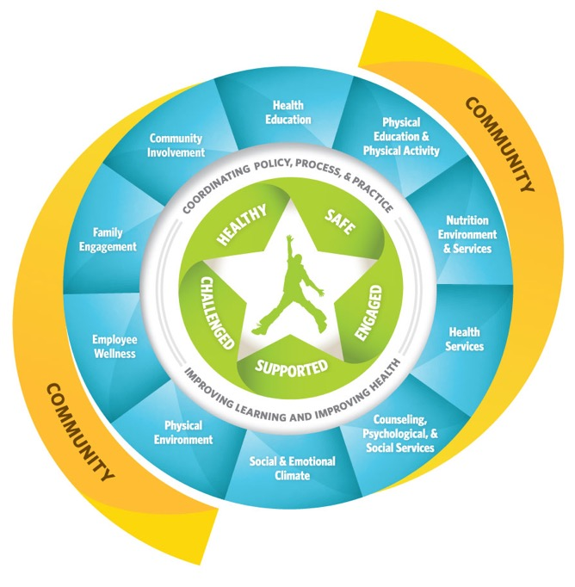
THE WHOLE SCHOOL, WHOLE COMMUNITY, WHOLE CHILD (WSCC) MODEL
Places the child at
the center
Takes a comprehensive approach to supporting learning and health
Calls for greater collaboration across sectors
Notes:
NOTES TO PRESENTER:
Pronounce “WSCC” as “whisk” or use the acronym WSCC
NARRATIVE:
The Whole School, Whole Community, Whole Child (WSCC) model provides a framework that schools can use to create a healthy environment that supports student success. The model is centered on children--our students--and fosters a comprehensive approach to addressing the barriers and supports for learning and health. It calls for a greater collaboration across the school, community, and health sectors to meet the needs and support the potential of each child. Regardless of your role in the school community, we all play a part in the implementation of the WSCC model.

Slide 3
OBJECTIVES
1
Define the WSCC Model
2
Describe the link between learning and health
Recognize the value of using the model to impact student achievement
3
Describe a step-by-step process for implementation of the model
4
Notes:
NARRATIVE:
By the end of this presentation, you will be able to:
Define the WSCC model,
Describe the link between learning and health,
Recognize the value of using the WSCC model to impact student achievement, and
Describe a step-by-step process for implementation of the model.

Slide 4

THE WSCC
IMPLEMENTATION
GUIDE
Description of the
model
Step-by-step guidance for districts and schools
Notes:
NARRATIVE:
This presentation is based on The Whole School, Whole Community, Whole Child Model: A Guide to Implementation. Developed in 2017 by the National Association of Chronic Disease Directors (NACDD) and funded by the Centers for Disease Control and Prevention (CDC), this guide provides a detailed description and step-by-step guidance to adopting and implementing the WSCC model.

Slide 5



LEARNING & HEALTH
Improved Academic Achievement
Better Health
References on the link between learning and health are available at: www.chronicdisease.org/resource/resmgr/school_health/wscc_ppt_references.pdf
Additional information can be found at: www.cdc.gov/healthyschools/health_and_academics/index.htm
Notes:
NOTES TO PRESENTER:
If appropriate, add speaking points that reflect local or state data.
NARRATIVE:
Academic achievement and health are closely linked, and healthy students are more ready and able to learn.
Here are some examples of what the research tells us:
When students’ nutritional and physical activity needs are met, they are able to attain higher academic achievement levels;¹⁻⁷
Providing students access to physical, mental, and oral health care improves attendance, behavior, and achievement;⁸⁻¹²
The development of connected and supportive school environments benefits teaching and learning, helps engage students, and enhances positive learning outcomes;^{13,14} and
A positive social and emotional climate increases academic achievement, reduces stress, and improves positive attitudes towards one’s self and others.^{15,16}
Just as health supports academic achievement, academic achievement also improves health. Academic achievement is an excellent indicator of children’s overall well-being^{17,18} and a strong predictor and determinant of adult health outcomes. Individuals with more education are likely to:
Live longer,
Experience better health outcomes, and
Practice health-promoting behaviors such as exercising regularly and refraining from smoking.¹⁹⁻²²
These positive outcomes are why many of the nation’s leading educational organizations recognize the need to address health and well-being within the educational environment.²³⁻²⁷

Slide 6
“We’ve made a commitment to integrate health and wellness into our schools. This is an important effort because research and first-hand experience clearly show that healthy students are more likely to be academically successful students.”
Chris Gdowski, Superintendent
Adams 12 Five Star Schools, Thornton, Colorado
Notes:
NARRATIVE:
Administrators, school staff, and their community partners across the country can use the WSCC model as a framework to support efforts to integrate health and wellness into their schools and make an impact on both learning and health outcomes.

Slide 7



HISTORY
Late 1980’s
CDC introduces the Coordinated School Health model
2007
ASCD introduces the Whole Child Initiative
2014
CDC and ASCD collaborate to develop WSCC
Notes:
NARRATIVE:
Let’s provide some historical context on how we came to use the WSCC model. The CDC developed the Coordinated School Health model in the late 1980s, primarily to encourage schools to take steps to promote health and prevent chronic disease. The Whole Child Initiative was introduced in 2007 by ASCD, a national education membership organization. The Whole Child Initiative is a comprehensive approach that encourages educators, parents, families, and the community to support and prepare children for success in school and in life.
In time, the education, public health, and school health sectors recognized the need for greater alignment, integration, and collaboration. In response to this call to action, the CDC and ASCD partnered to develop the WSCC model.
Let’s look at the model more closely.

Slide 8

THE FIVE WHOLE CHILD TENETS
Notes:
NARRATIVE:
When you look at the WSCC model you will see the student, the primary focus of the model, at the center. In the green ring surrounding the student are the five tenets of the whole child: healthy, safe, engaged, supported, and challenged. These tenets are critical for supporting student academic achievement and health. Think about Maslow’s Hierarchy of Needs. As you might recall, this theory states that before we can meet our social and emotional needs, we must first meet our physical needs. The Whole Child tenets are structured to reflect this. The tenets of healthy and safe provide the foundation for students to be engaged, supported, and challenged.
FOR EXTENDED VERSION:
What does each tenet really mean?
HEALTHY means each student will enter school healthy and learn about and practice a healthy lifestyle. Emotionally and physically healthy students do better in school.
SAFE means each student learns in an environment that is physically and emotionally safe for students and adults. Students who feel safe concentrate better and are more likely to connect with their teachers and peers.
ENGAGED means each student is actively engaged in learning and feels connected to the school and broader community. Students who feel valued as a part of their school community perform better academically.
SUPPORTED means each student has access to personalized learning and is supported by qualified, caring adults. Students who have an adult take a personal interest in them are less likely to drop out, engage in negative behavior, and feel isolated.
CHALLENGED means each student is challenged academically and graduates college or career ready.

Slide 9
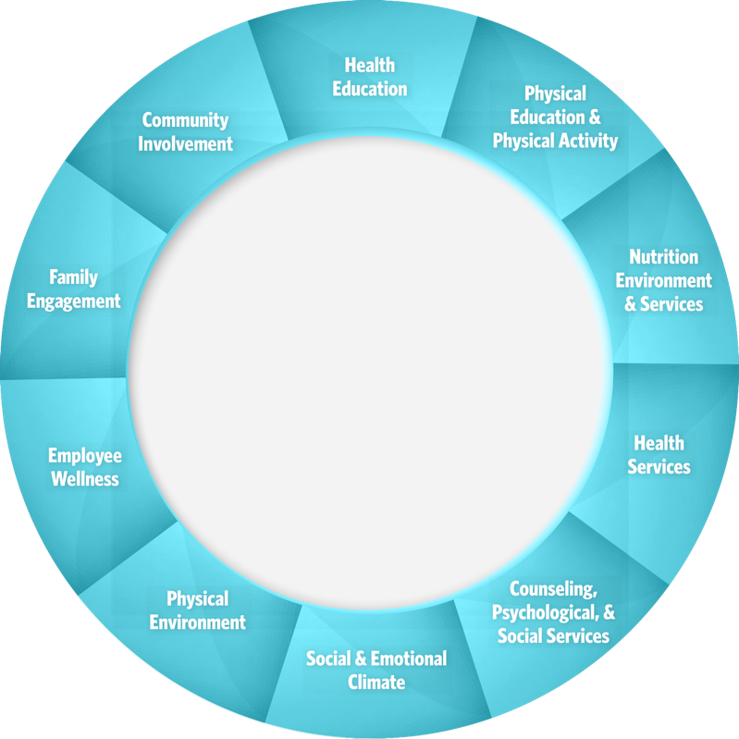

THE TEN WSCC COMPONENTS
Notes:
NOTES TO PRESENTER:
Descriptions of the components are adapted from www.cdc.gov/healthyyouth/wscc/components.htm and www.ascd.org/ASCD/pdf/siteASCD/publications/wholechild/wscc-a-collaborative-approach.pdf.
Detailed descriptions of the components are also available on pages 8-9 of The Whole School, Whole Community, Whole Child: A Guide to Implementation. Additional resources for each component are listed on pages 59-61 of the Guide.
NARRATIVE:
The blue ring shows the 10 components of school health.
The 10 components are:
Health education
Physical education and physical activity
Nutrition environment and services
Health services
Counseling, psychological, and social services
Social and emotional climate
Physical environment
Employee wellness
Family engagement
Community involvement
FOR EXTENDED VERSION:
Health education describes formal instruction that provides students with the opportunity to learn content and practice skills needed to improve health and prevent disease.
Physical education and physical activity refers to a comprehensive program which includes physical education; physical activity before, during, and after school; staff involvement; and family and community involvement.
Nutrition environment and services includes teaching students healthy eating through nutrition education and messages about healthy eating choices, as well as providing healthy food and beverage options for students through vending machines, concession stands, school stores, food carts, the cafeteria, classroom parties, celebrations, and fundraisers.
Health services in schools provide first aid, emergency care, and management of students’ chronic conditions such as asthma, food allergies, and diabetes. Health services also provide health screenings and referrals to healthcare providers.
Counseling, psychological, and social services support the mental, behavioral, and social-emotional health of students. This may include assessments, interventions to address concerns, and referrals to school and community support services.
Social and emotional climate refers to the psychosocial aspects of how students engage in school and relate to staff and other students.
Physical environment refers to the physical condition of a school and addresses physical safety and biological and chemical contaminants in the air, water, and soil.
Employee wellness supports student health by encouraging staff to serve as healthy role models for students. Fostering the physical and mental health of staff through wellness programs and policies increases employee effectiveness and productivity, thereby supporting student achievement.
Family engagement emphasizes the role school staff have in working together with families to support students in their learning and development.
Community involvement encourages partnerships between schools and community groups, local businesses, universities, government agencies, and other organizations to support students.

Slide 10

EXPANSION OF THE COMPONENTS
Healthy and Safe
School Environment
Family/
Community Involvement
Social &
Emotional Climate
Physical
Environment
Community
Involvement
Family
Engagement
Change made to reflect the importance and difference between the psychological and physical environments of a school.
Change made to emphasize the role of community organizations, businesses, and families.
Notes:
NOTES TO PRESENTER:
If your audience is familiar with the Coordinated School Health model, they may find this information beneficial. If not, OMIT this slide.
NARRATIVE:
For those of you familiar with the Coordinated School Health model, these components likely appear similar with a few minor changes.
The model changed the original component of Healthy and Safe School Environment into two components: Social and Emotional Climate, and Physical Environment. This change was made to reflect the difference between the psychosocial and physical environment of a school.
Another change in components was splitting Family and Community Involvement into two distinct components to emphasize the role of community organizations and businesses as well as the critical importance of families.
And finally, Health Promotion for Staff was changed to Employee Wellness.

Slide 11
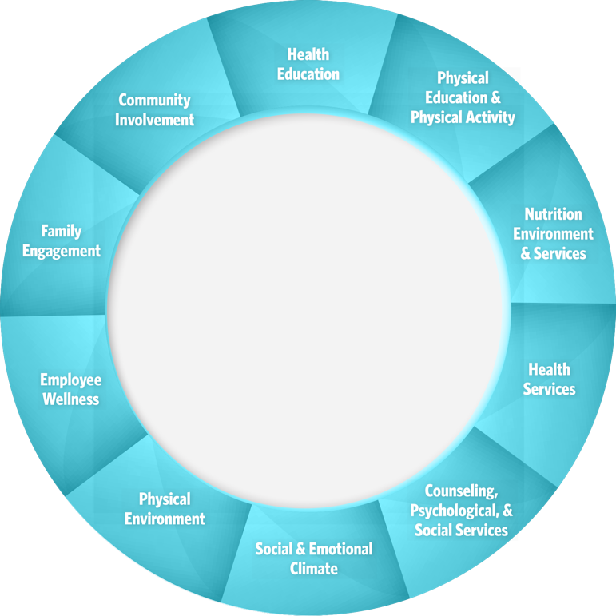
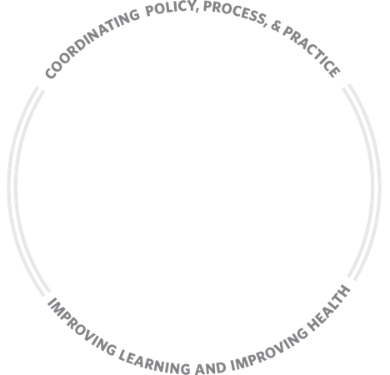

COORDINATING POLICY,
PROCESS, & PRACTICE
Coordinate and collaborate among component areas
Facilitate awareness
of issues
Leverage resources
Reduce program duplication and fill gaps
Notes:
NARRATIVE:
The next part of the WSCC model is the white ring between the five Whole Child tenets and the ten components. It is the coordination of policies, processes, and practices that helps put this model into action and leads to improved learning and health outcomes. What does this look like?
In schools and districts, the model can guide coordination and collaboration to address issues such as attendance, behavior, school climate, student health, and academic outcomes. Coordination among the component areas and the community is critical as it provides a way to leverage resources, reduce duplication of efforts and programs, and fill in the gaps to address the priorities in a school or district.
One of the best strategies for establishing coordination is to expand an existing committee or convene a new team with representation of as many of the WSCC components as possible. This work is not meant to be on the shoulders of one teacher, one nurse, one department, or one profession within the school or district. It is a whole school approach, with every adult and every student playing a role.

Slide 12

THE COMMUNITY
Schools are part of a community and support from the community is essential.
School-community collaborations can be built with:
Local health departments
Hospitals
Businesses
Social service agencies
Parks & recreation
Law enforcement
Churches
Notes:
NARRATIVE:
Lastly, the outside yellow ring of the model represents the community. Remember, schools are part of a community, and support from that community is essential. Schools will be more effective and accomplish more when there are community collaborations connected to each of the components.
Partnerships with local health departments, hospitals, businesses, social service agencies, and a variety of other entities in the community can help schools accomplish their goals. Building these relationships takes time but is well worth it in the long run.

Slide 13
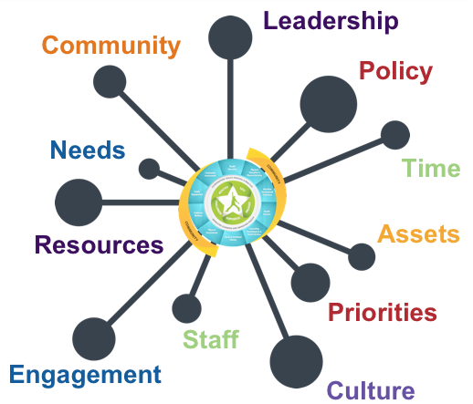
THE WSCC MODEL IN ACTION
A framework that
can be modified and adapted to meet the unique needs of districts, schools, and communities.
Staff
Notes:
NARRATIVE:
So how does the WSCC model work? There is no single answer to this question. While there are promising practices to help facilitate WSCC adoption, there is no prescribed approach to using it. Implementation of the model can vary depending on district and school leadership, policy, culture, school and community needs and assets, staff availability, time, resources, family engagement, and community involvement. The WSCC model may look different in each school depending on the unique needs of the students, school staff, and community priorities.
But that’s the beauty of the model! It is a framework that can be adapted to meet the local needs of districts, schools, and communities.

Slide 14




ALIGNMENT WITH EDUCATION POLICY
Federal
State
District
School
Notes:
NOTES TO PRESENTER:
If appropriate, add examples of policies, practices, funding sources, and accountability measures specific to your district or school.
NARRATIVE:
Whether they know it or not, most schools and districts are already implementing the WSCC model in some way! Schools and districts have existing policies, practices, funding sources and accountability measures from the federal-, state-, district - and/or school-level that address non-academic barriers to learning, including student health and healthy school environments. The WSCC model provides support and a collaborative framework to meet and exceed these policies and practices.
FOR EXTENDED VERSION:
Let's talk about some of these existing policies and how they relate to health and wellness in schools:
At the federal level, the Every Student Succeeds Act (ESSA) of 2015 provides several opportunities to integrate health into education policies and practices through state accountability systems, state report cards, and school improvement plans.
State-level policies related to the WSCC model are governed by various legislated statutes, state agency rules and regulations, state board of education policies and/or state board of health or nursing regulations.
The WSCC model can be used to guide development of a district and school’s mission, vision, and strategic plan to foster whole child initiatives and supports. School leaders may consider opportunities to incorporate whole child language and priorities into school-level policies and practices, including school improvement planning and wellness policies, based on the needs of students and staff.

Slide 15


WHAT IS MY ROLE?
School board member
Superintendent
School principal
School staff
Family member or parent
Student
Community partner
Notes:
NOTES TO PRESENTER:
Select roles to be highlighted and/or add specific details about how you want various roles to be involved in implementing the WSCC model in your school or district.
NARRATIVE:
Everyone has a role to play in implementing the WSCC model.
For example:
School board members can support implementation and funding for evidence-based policies, processes, and practices that care for the whole child.
Superintendents can create a district mission and vision and identify accountability metrics that align with the WSCC model.
Principals can champion the WSCC model by prioritizing its implementation, allocating time for and providing professional development for school staff, and communicating its importance.
School staff can participate in the planning process and implementation of the WSCC model.
Parents or family members can serve on the school or district WSCC Team.
Students can serve as WSCC team members and advocate for the needs of their peers.
Community members can share expertise and resources to complement and support what schools are doing.
In addition to these stakeholders, there are district and school staff who directly represent the various components, such as health and physical education teachers, nutrition service managers and staff, school nurses, school-based health center staff, school counselors and psychologists, facilities staff, and employee benefits managers, to name a few. They may take the lead on implementing practices within their component and coordinating with others.
I have mentioned the WSCC Team a couple of times. Many districts and schools have existing committees that address student and staff health, such as a school health advisory committee. They may also have school improvement planning teams or parent teacher organizations. These groups can be expanded or adapted so that team members reflect the ten components of the WSCC model.

Slide 16
STEPS TO ADOPTING THE WSCC MODEL
Step 1
Focus on Administrative Buy-in & Support
Identify a WSCC Coordinator & WSCC Team Leaders
Step 2
Step 3
Assemble a District and School Team
2
Step 4
Assess and Plan WSCC Efforts
Step 5
Implement the Plan
Step 6
Reflect and Celebrate
Notes:
NOTES TO PRESENTER:
This slide aligns with Part 2 of The Whole School, Whole Community, Whole Child Model: A Guide to Implementation. Consider having a copy of the guide available for participants.
Consider adding some talking points related to where your school or district is in relation to these steps.
NARRATIVE:
Where do we start? The Whole School, Whole Community, Whole Child: A Guide to Implementation gives step-by-step guidance for district and school staff seeking to adopt and implement the model. Let’s take a look at the steps to adopting the WSCC model.
The steps are:
Focus on Administrative Buy in and Support,
Identify a WSCC Coordinator and WSCC Team Leaders,
Assemble a District and School Team,
Assess and Plan WSCC Efforts,
Implement the Plan, and finally
Reflect and Celebrate
While the steps are intended to be implemented chronologically, the process is not always linear. Schools and districts can enter the step-by-step process at any point and revisit steps as needed.
The Guide includes guidance, checklists, and tips for each step as well as worksheets to help teams document and create a written history of their progress.
IF PRESENTATION ENDS HERE: SKIP TO SLIDE 28 (Call to Action Slide)
IF PRESENTATION CONTINUES:
Let’s look at some examples of how this model can work in practice.

Slide 17



THE WSCC MODEL IN ACTION: EXAMPLE
Nutrition services will implement a school breakfast program
School teachers & staff
will model good nutrition
Principal will include healthy eating section
in e-newsletter
A school health team
forms at the school
Notes:
NOTES TO PRESENTER:
Three examples of “The WSCC Model in Action” are provided on the next several slides. Choose up to two examples to present.
Slides 17-18: Fictional example—healthy eating at the school level
Slides 19-22: Denver Public Schools, Denver, Colorado (large, urban district)
Slides 23-25: Yellville-Summit School District, Yellville, Arkansas (small, rural district)
NARRATIVE:
What does the model look like when it is put into practice? Remember, there is no one way to implement the model--schools and districts can do what works for their situation.
In this fictional example, efforts to address healthy eating start by addressing a few components of the WSCC model and then expand over time to include more components. Many districts find it helpful to start out this way.
Main Street Elementary formed a school health team with a staff member representing each of the 10 components of the WSCC model. The principal was also a member of the team.
The team started by completing the CDC’s School Health Index. Based on scientific guidance, the School Health Index includes the policies and practices most likely to be effective in reducing youth health risk behaviors and supporting healthy behaviors.²⁸ The team found that many policies and practices were already being implemented in the school, but there were some improvements to make.
The team wanted to address nutrition as a way to improve student health, behavior, and academic achievement. They reviewed research showing that better nutrition, particularly eating a healthy breakfast, enhances cognitive performance (including attention, memory and problem solving), increases attendance rates, reduces visits to the health office, reduces absenteeism, and improves psychosocial function and mood.²⁹⁻³⁹ Based on this information, the team identified three priority actions for the current school year:
The nutrition services manager and staff would implement a school breakfast program.
Teachers and staff would serve as healthy role models for students by consuming healthier foods and drinks in front of students. To coordinate with the new breakfast program, the staff would focus on modeling these behaviors during breakfast.
The principal, along with several teachers, would include a healthy eating section with nutrition information in the monthly e-newsletter sent to families. The first issues of the e-newsletter would include promotion of the new breakfast program and the importance of breakfast for student health and learning outcomes.

Slide 18

THE WSCC MODEL IN ACTION: EXAMPLE
Decreased visits to health office
Increased school attendance
Improved cognitive performance
Notes:
NARRATIVE:
As you can see in this example, policies and practices from several components of the WSCC model--Nutrition Environment and Services, Employee Wellness, and Family Engagement--were implemented. Over the course of several months, data collected by the school health team showed improved healthy eating, decreased visits to the heath office, increased attendance, and improved cognitive performance in class as a result of their efforts.
Coordination among these components built a foundation for the team to address other issues. Over time, the team prioritized other policies and practices. For example, the school health team began talking to the local after school directors about the school’s efforts to improve nutrition. The group began to brainstorm how these programs could implement some of the same practices, such as providing snacks that meet the USDA Smart Snack guidelines.

Slide 19


THE WSCC MODEL IN ACTION: DENVER PUBLIC SCHOOLS
District mission: Every Child Succeeds
Denver Plan 2020 includes Support the Whole Child as a goal
Notes:
NARRATIVE:
If example 1 was presented, read this paragraph:
In some cases, a district or school may have the capacity to address all ten components of the model.
If example 1 was not presented, read this paragraph:
What does the model look like when is put into practice? Remember, there is no one way to implement the model--schools and districts can do what works for their situation. In some cases, efforts to implement the WSCC model start with one or two components and build over time. In this example, Denver Public Schools addresses health and well-being through all ten components.
--
With more than 92,000 students in over 200 schools, Denver Public Schools is among the fastest growing urban school districts in the nation, serving a diverse student population where approximately 67% of students qualify for free and reduced-price lunch and 37% are English-language learners. The district vision is “Every Child Succeeds.” One of the five goals in the district’s strategic plan, Denver Plan 2020, is “Support the Whole Child.” To achieve this goal, Denver Public Schools is committed to providing equitable and inclusive environments that ensure students are healthy, supported, engaged, challenged, safe, and socially and emotionally intelligent. ⁴⁰
Sound familiar? These are the five tenets of the WSCC model with one addition. Students advocated to include socially and emotionally intelligent, as well.⁴¹

Slide 20

THE WSCC MODEL IN ACTION: DENVER PUBLIC SCHOOLS
Increase in number of students:
Eating breakfast
Enrolled in health insurance
Receiving healthcare through a school-based health center
Notes:
NARRATIVE:
In alignment with their vision and goals, in 2010, the district developed its Health Agenda 2015, a five-year strategic plan to promote the health and wellness of every student. The District Health Advisory Committee led the development of the plan with input and collaboration from more than 1200 students, parents, staff, and community partners. After implementing the plan, Denver Public Schools saw an increase in the number of students eating a nutritious breakfast, the number of students enrolled in health insurance, the number of students receiving healthcare through a school-based health center, and the number of school nurses, school psychologists, and school social workers providing vital support to students.⁴¹⁻⁴²
The second iteration of this plan, Whole Child, Healthy Child Agenda 2020, expanded the stakeholder engagement process to include 4000 stakeholders. The plan now outlines objectives and performance metrics in all 10 components of the WSCC model.

Slide 21
Health services | Increase the number of students who receive a universal health screening and referral for follow-up services, when applicable. Performance metric: 100% of students who do not meet screening benchmarks will be referred for follow-up services.
Social and emotional climate | Increase the number of schools implementing evidence-based, culturally inclusive approaches and practices to support an emotionally safe school climate. Performance metric: 100% of schools will implement at least three approaches and practices at the universal level.
Physical environment | Increase the number of DPS facilities implementing evidence-based practices to ensure healthy and safe physical environments. Performance metric: 100% of DPS facilities will implement at least three practices to ensure healthy and safe physical environments.
Notes:
NARRATIVE:
There are 1-2 objectives per component and each objective has 1-4 performance metrics. Here’s just a sampling of the objectives and metrics:
For health services, the objective is to increase the number of students who receive a universal health screening and referral for follow-up services, when applicable.
For social and emotional climate, the objective is to increase the number of schools implementing evidence-based, culturally inclusive approaches and practices to support an emotionally safe school climate.
For physical environment, the objective is to increase the number of DPS facilities implementing evidence-based practices to ensure healthy and safe physical environments.
To achieve the district’s objectives and performance metrics, administrators and staff are asked to utilize resources at the school level. Their efforts and activities may vary depending on the assets and resources of the school.

Slide 22
“We at DPS are focusing our efforts and attention around Whole Child supports because we know – and research shows – it will not only improve academic outcomes, but is critical to achieving our vision that Every Child Succeeds.”
Katherine Plog Martinez, Executive Director of Whole Child Support, Denver Public Schools, Denver, Colorado
Notes:
NARRATIVE:
Going forward, Denver Public Schools plans to continue to develop deeper systems of supports for implementing Whole Child goals and objectives, with the focus on ensuring that their vision of “Every Child Succeeds” becomes reality.⁴¹

Slide 23

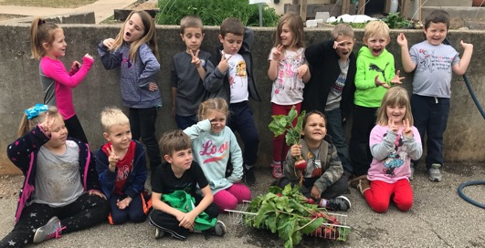
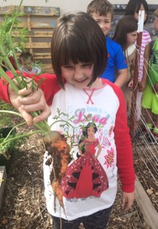
THE WSCC MODEL IN ACTION:
YELLVILLE-SUMMIT PUBLIC SCHOOLS
Decrease rate of:
Obesity/ overweight
Absenteeism
Notes:
NARRATIVE:
Yellville-Summit School District is a small district that is making big changes to impact student learning and health outcomes. Located in rural Arkansas, the district serves 739 students in an elementary and high school. The district’s free and reduced lunch rate is over 70%. Several years ago, the Body Mass Index (BMI) Program was instituted in Arkansas to collect BMI in public schools to measure childhood obesity trends. Based on this data, which showed that 45% of their high school students were overweight or obese, Yellville-Summit prioritized addressing nutrition and physical activity. Data also showed chronic absenteeism among specific students. Over 10% of students had missed 30 or more days.

Slide 24
THE WSCC MODEL IN ACTION:
YELLVILLE-SUMMIT PUBLIC SCHOOLS
Nutrition education
Farm to School practices
School breakfast program
Physical activity breaks
School-based health center
Playground improvements
Shared use agreements
Parent and student cooking and nutrition programs
Notes:
NARRATIVE:
Yellville-Summit School District utilizes the WSCC framework to address nutrition and physical activity to impact overweight and obesity and in turn, academic indicators such as absenteeism.
The district wellness policy includes several best practices that promote and support nutrition and physical activity. The district has a school health coordinator and wellness committee charged with making policy recommendations to the school board and monitoring policy implementation progress in each school.
Efforts to improve nutrition include nutrition education in the elementary school, Farm to School and USDA Smarter Lunchroom practices, a school breakfast program, a school garden, and nutrition and cooking programs for students and parents. Physical activity is addressed through classroom activity breaks, shared use agreements between the district and community, playground improvements, and implementation of a PE curriculum across the district.
In addition, a school-based health clinic provides physical and mental health services to students.
Partnerships with Extension Services, AmeriCorps and Arkansas Children’s Hospital support and complement these efforts.
As you can see, multiple components of the WSCC model are reflected in these efforts.

Slide 25
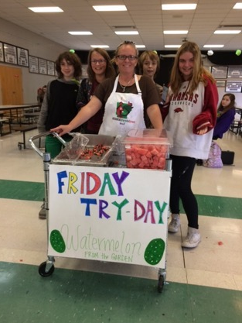
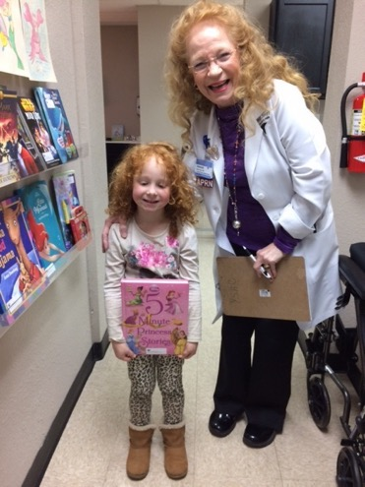
THE WSCC MODEL IN ACTION:
YELLVILLE-SUMMIT PUBLIC SCHOOLS
Increase in requests for fresh fruit and vegetables at home
Increase in willingness to try new food items in the cafeteria
Decrease in health room visits
Increase in attention and focus in the classroom
Notes:
NARRATIVE:
As a result of these efforts, parent surveys indicate students are requesting fresh produce and eating more fruits and vegetables at home. Student have shown an increased willingness to try new food items in the cafeteria. Through the school breakfast program, school nurses report a decrease in health room visits – meaning students are in class and learning rather than in the nurse’s office. At the same time, teachers report that students have greater attention and focus in the classroom.
The district recognizes the value of the WSCC model and is working to sustain their efforts to impact the health and leaning outcomes of their students.

Slide 26


VIDEO:
INTRODUCING THE WSCC MODEL
www.chronicdisease.org/shvideos
Notes:
NOTES TO PRESENTER:
Two video options are provided on slides 26-27. If time allows, you may wish to choose one of these videos to include in your presentation:
Slide 26: WSCC teaser (promotional) video (approximately 01:10)
Slide 27: WSCC Benefits and Impacts video (approximately 04:20)
NARRATIVE:
The National Association of Chronic Disease Directors (NACDD) has developed several videos to increase awareness and promote implementation of the WSCC model. The videos feature three school districts: Balsz School District in Phoenix, Arizona; Springfield School District in Springfield, Vermont; and Stanfield Elementary School District in Stanfield, Arizona. This brief teaser video is designed to introduce the WSCC model. All videos can be found at the link on this slide.

Slide 27
VIDEO:
WSCC BENEFITS AND IMPACT ON STUDENT LEARNING AND HEALTH
www.chronicdisease.org/shvideos
Notes:
NARRATIVE:
The National Association of Chronic Disease Directors (NACDD) has developed several videos to increase awareness and promote implementation of the WSCC model. The videos feature three school districts: Balsz School District in Phoenix, Arizona; Springfield School District in Springfield, Vermont; and Stanfield Elementary School District in Stanfield, Arizona. The content of each of the three primary videos focuses on a particular area, or theme. This video shows the benefits and impact of the WSCC model on student learning and health. The other two videos highlight administrator support and commitment for WSCC and ease of WSCC implementation. All videos can be found at the link on this slide.

Slide 28
CALL TO ACTION
Notes:
NOTES TO PRESENTER:
If desired, add Call to Action specific to the audience here.
What do you want your audience do to?
What are you proposing to your audience?
What do you need from your audience?
What are the next steps for your audience?
Examples:
We ask parents, families, and students to advocate for and participate in health and wellness improvements in our district and schools.
We ask district and school leaders and administrators to focus resources on implementation of policies, processes, and practices to improve student health and wellness and support the whole child.
We ask community partners to partner with us to support whole child efforts within our district and schools.⁴²

Slide 29
ADDITIONAL RESOURCES
CDC
WSCC: www.cdc.gov/healthyschools/wscc/index.htm
Healthy Schools Website: www.cdc.gov/healthyschools/index.htm
Virtual Healthy School: www.cdc.gov/healthyschools/vhs/index.html
School Health Index: www.cdc.gov/healthyschools/shi/index.htm
NACDD
School Health Website: www.chronicdisease.org/schoolhealth
Resource Guide: www.nacddresourceguide.org/schoolhealth
WSCC Video Series: www.chronicdisease.org/shvideos
Notes:
NARRATIVE:
Additional resources that support implementation of the WSCC model are listed on this slide.

Slide 30

THANK YOU!
Name
Email, Phone
Notes:
NOTES TO PRESENTER:
Add your contact information to the slide if desired.
NARRATIVE:
As you can see, the Whole School, Whole Community, Whole Child model provides a framework for ensuring that each child, in each school, in each of our communities can be healthy, safe, engaged, supported, and challenged. That’s what a whole child approach to learning, teaching, and community engagement really is about. It’s more than achievement or academics. The whole child approach views the collaboration between learning and health as fundamental.
Thank you! You can contact me at (email) or (phone).

Slide 31

This presentation was developed by the National Association of Chronic Disease Directors (NACDD) School Health Project, which provides resources, training, and technical assistance to help state health and education agencies make informed decisions about a variety of school health issues.
Learn more at chronicdisease.org.
Published June 2018
Notes:
NOTES TO PRESENTER:
This slide is for your information and does not need to be included in your presentation.

Slide 32
NACDD CONTACT INFORMATION
Laura Frankel DeStigter, MPH
NACDD Consultant
ldestigter@chronicdisease.org
Amanda K. Martinez, MPH, MSN, RN
NACDD Consultant
amartinez@chronicdisease.org
Notes:
NOTES TO PRESENTER:
This slide is for your information and does not need to be included in your presentation.

Slide 33
DISCLAIMERS
This presentation was produced under a cooperative agreement with the Centers for Disease Control and Prevention (CDC). Its contents are solely the responsibility of the authors and do not necessarily represent the official views of NACDD or CDC.
Please note that the photos in this presentation are copyrighted and proprietary to the National Association of Chronic Disease Directors. The presentation may be used and adapted for educational purpose. Re-using photos in this presentation for other purposes without prior permission is prohibited. For questions, or if you need a copy of this presentation in another format, please contact NACDD.
Notes:
NOTES TO PRESENTER:
This slide is for your information and does not need to be included in your presentation.

